Slide 1


ECE651: MIDTERM PROJECT REVIEW
Prepared by: Group 23
Bansi Donga (20989264) Khushi Barot (20988108) Naitikkumar Prajapati (20986782) Rashmi Gediya (21033561) Sunnykumar Kalola (20989263)
PAGE 1

Slide 2
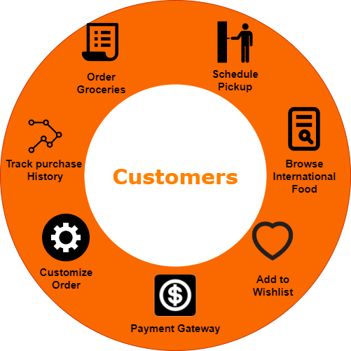

Overview
PAGE 2
Photo credit: @bruce.digital

Slide 3
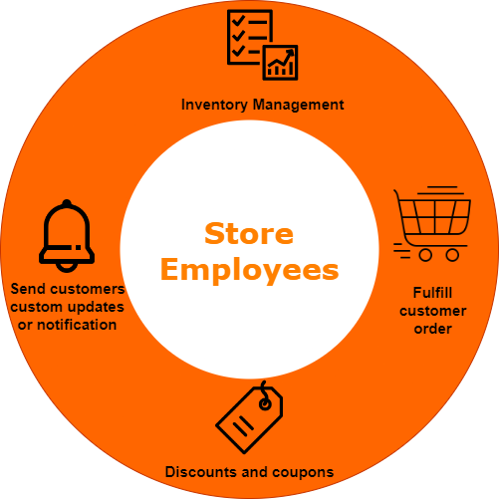
Overview
Photo credit: @bruce.digital
PAGE 3

Slide 4

TECHNOLOGY USED...
PAGE 4

Slide 5
DEVELOPMENT PRACTICES
Agile methodology
Weekly meetings
Biweekly sprints
Version control system: GitLab
Project management tool:
GitLab Issue tracking board
Continuous integration / Continuous deployment pipeline
Code reviews
Testing
Documentation
Retrospective meetings after each sprint
PAGE 5
Photo credit: @bruce.dial

Slide 6

GITLAB ISSUE BOARD
Kanban board: https://git.uwaterloo.ca/ece_651/desi_kart/-/boards/4628
Each sprint is represented as a milestone.
For eg: https://git.uwaterloo.ca/ece_651/desi_kart/-/milestones
Workflow:
PAGE 6

Slide 7
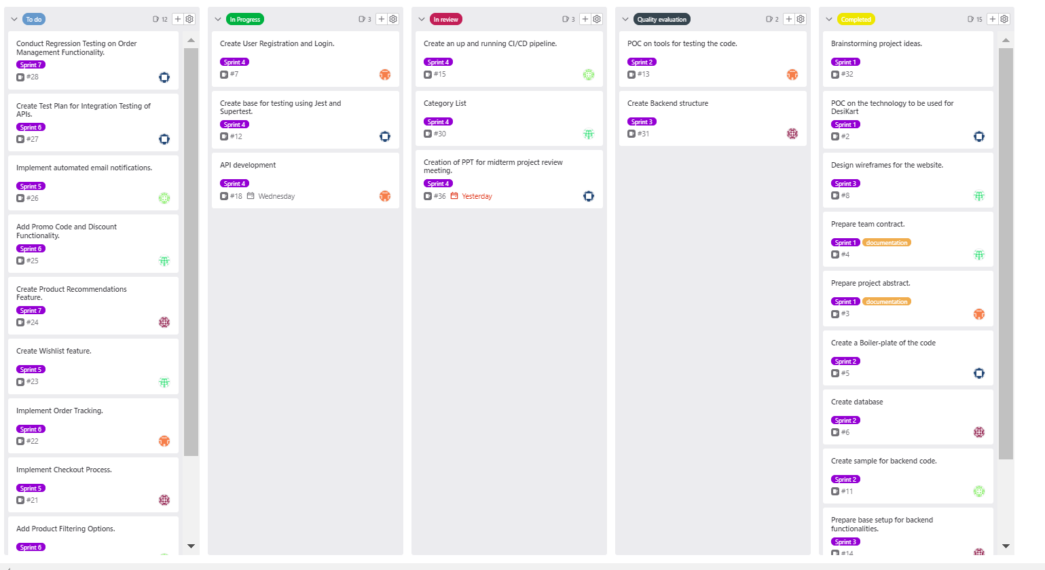
GITLAB ISSUE BOARD
Kanban board: https://git.uwaterloo.ca/ece_651/desi_kart/-/boards/4628
PAGE 6

Slide 8
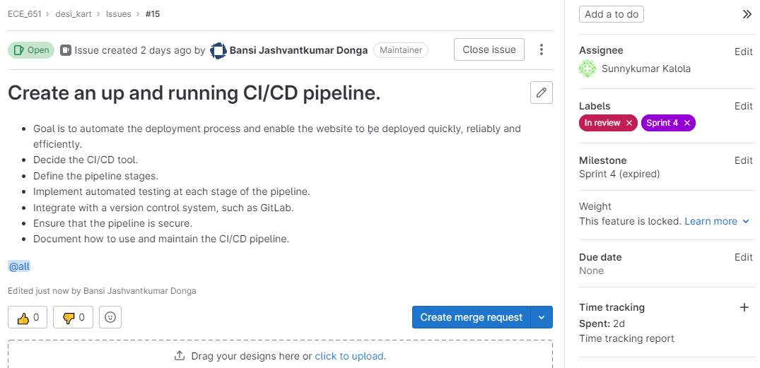
GITLAB TICKET
PAGE 6

Slide 9
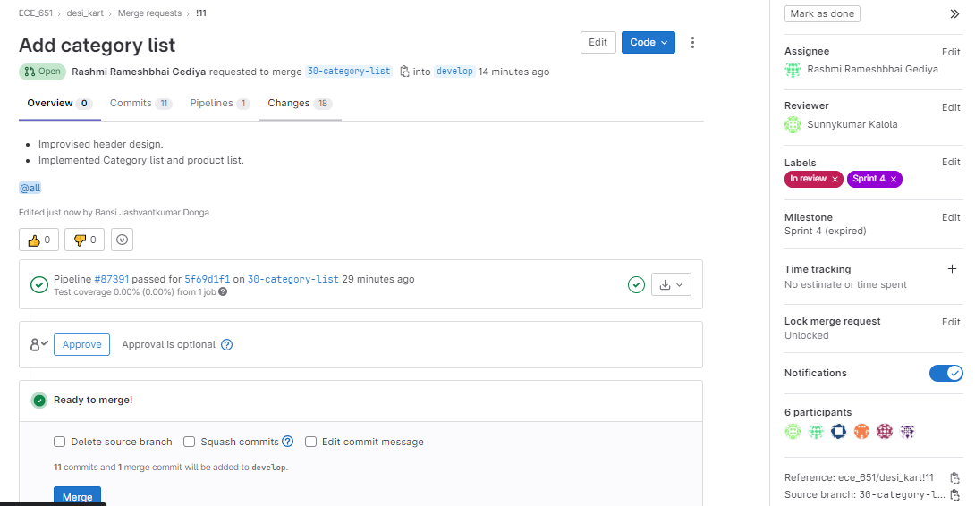
GITLAB MERGE REQUEST
PAGE 6

Slide 10
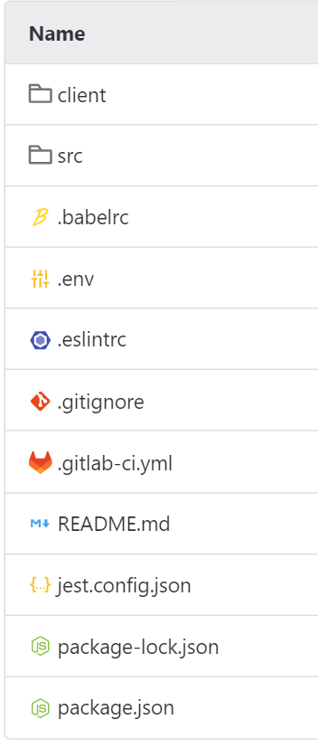
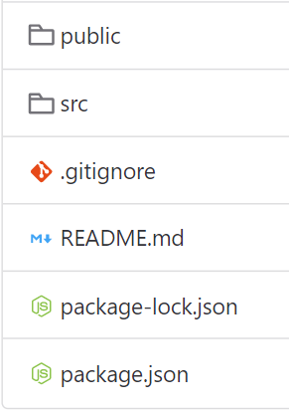
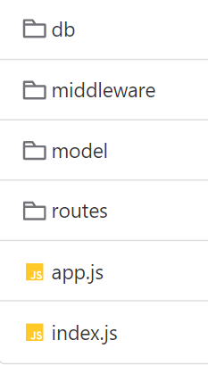
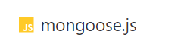
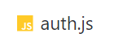
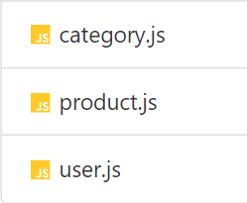
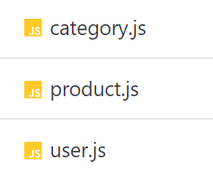
CODE STRUCTURE
Root
PAGE 10

Slide 11
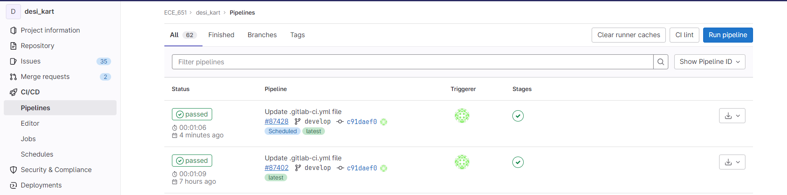
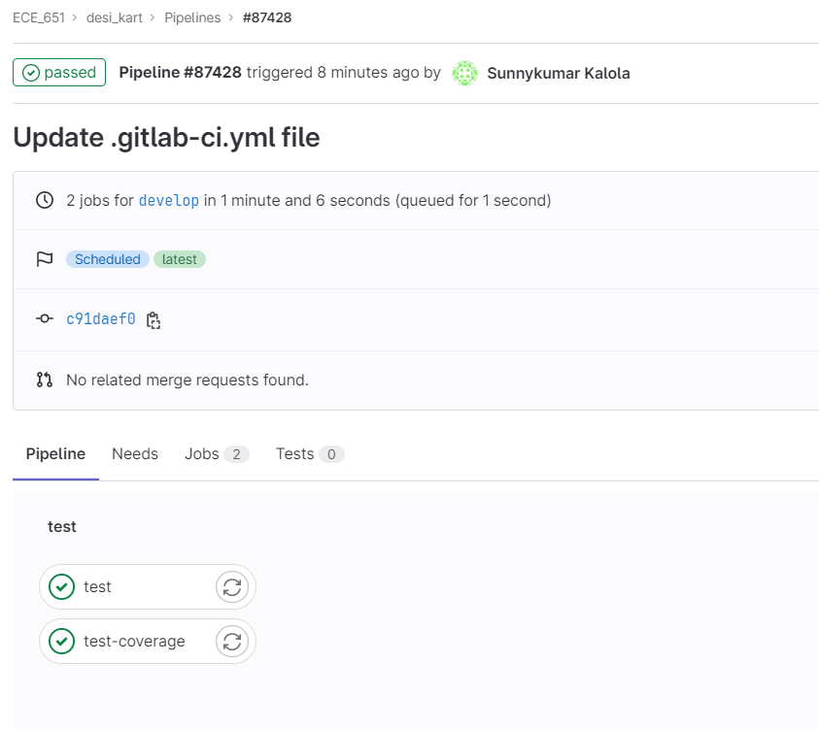
PIPELINE
PAGE 7

Slide 12
DOCUMENTATION SO FAR…
Project abstract
Team contract
Software requirement specifications (SRS) document
Test design document (TDD)
Presentation for midterm project review meeting
PAGE 7

Slide 13
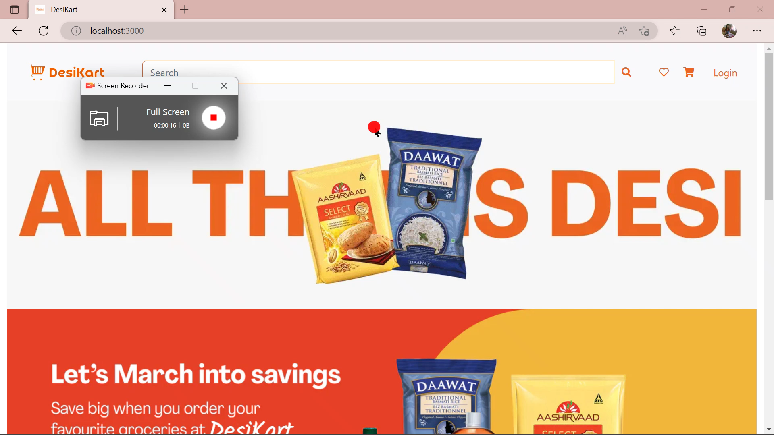
WEBSITE DEMO
PAGE 13

Slide 14

LOGIN PAGE PHOTO
PAGE 14

